Slide 1

Hass Avocado Dashboard
Andrew Jensen

Slide 2
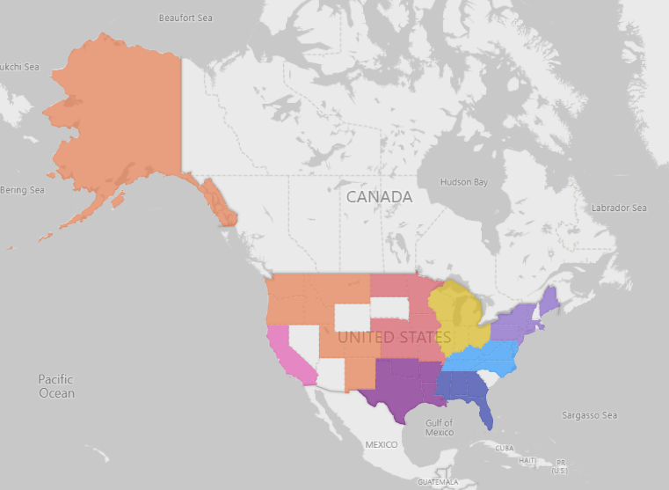
What did I build?
A dashboard to show the volume of avocado sales and other statistics by region

Slide 3
Purpose and objective
Give the company a better picture of who they are selling to.
Improve marketing efforts nationwide/worldwide.

Slide 4
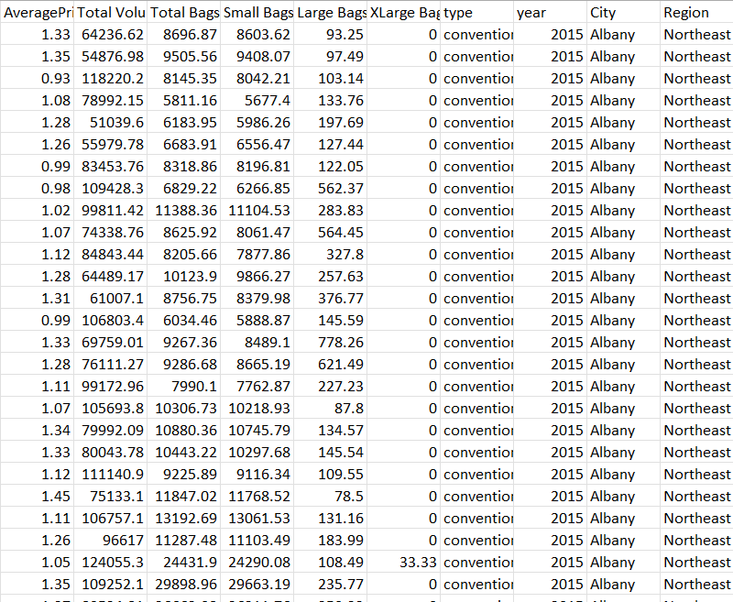
Overcoming obstacles
In order to solve the problems surrounding the city and region, I created an Excel formula to identify associating cities and regions and applied it to the whole data set.

Slide 5
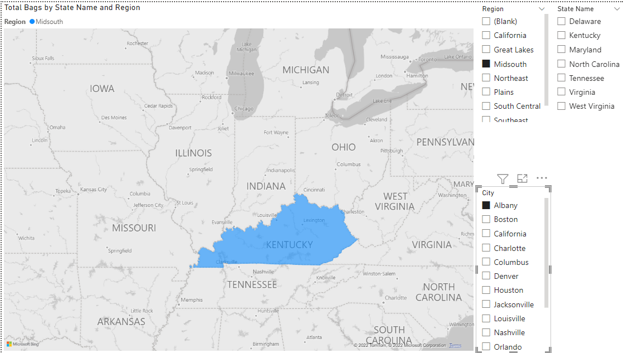
Example of separating the state from the region

